Slide 1
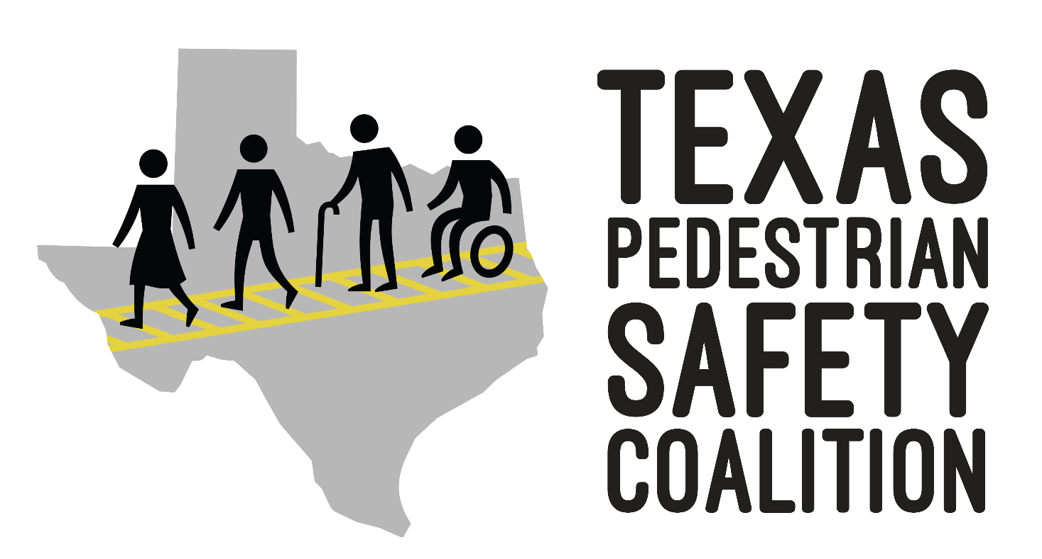
Texas Pedestrian Safety Coalition Meeting
Thursday, November 16, 2023

Slide 2
Agenda
10:30 – 10:40: Welcome and Introductions
10:40 – 10:50: Current Statewide and National Data
10:50 – 10:55: Texas Pedestrian Safety Activities
10:55 – 11:00: 2024 Texas Pedestrian Safety Forum
11:00 – 11:20: 2023-24 Pedestrian Safety Task Force
11:20 – 11:45: Moderated Discussion on Mid-Block Crossing / Jaywalking
11:45 – 12:00: Stakeholder Updates
12:00: Adjourn
Notes:
https://www.sfexaminer.com/marketplace/understanding-the-new-california-jaywalking-law/article_8ca6b542-b87d-11ed-b108-cb029a9ab516.html
Stakeholder Updates (10)
Craig Casper - Providing update on PROWAG

Slide 3
Texas Pedestrian Safety Coalition
Texas Pedestrian Safety Coalition - Texas Pedestrian Safety Coalition (texaspedsafety.org)
The goal of the Texas State Pedestrian Safety Coalition (TSPSC) is to reduce pedestrian fatalities and injuries in Texas communities.
TSPSC serves as a public forum that promotes and improves pedestrian safety by identifying partnerships and opportunities for collaboration and capacity building, as well as facilitating statewide communication around statewide safety laws.

Slide 4
Pedestrian Deaths per 100,000 in the U.S. 2021
Source: 2021 Traffic Safety Stats, NHTSA
Notes:
When looking at the trends nationally, Texas had the tenth most pedestrian deaths per 100 thousand people across the Unites States in 2021. GHSA projects that pedestrian deaths in Texas will increase to 2.78 deaths per 100K in 2022

Slide 5
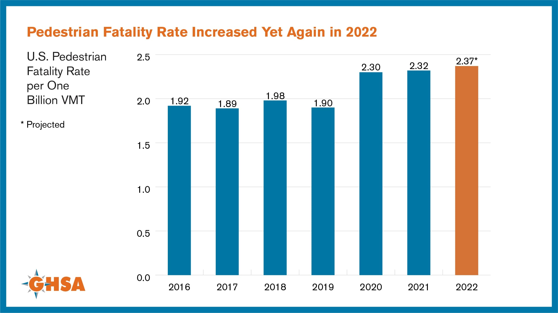

Slide 6
Pedestrian Serious Injuries and Fatalities in Texas 2014 - 2022
(Source: TxDOT Crash Reports and Records, 2022)C
Notes:
When we look at Texas, we see that, overall, pedestrian fatalities and serious injuries have steadily increased between 2014 and 2022. In 2022, Texas pedestrians suffered the most deaths and serious injuries in the past 8 years.

Slide 7
Pedestrian Serious Injuries and Fatalities in Texas 2014 - 2022
17.3%
Percent of Fatalities
5.8%
Percent of Serious Injuries
(Source: TxDOT Crash Reports and Records, 2022)
Notes:
When we look at the proportion of serious injuries and fatalities that were pedestrian related in 2022, the total number of serious injuries amounted to 5.8% of all transportation related serious injuries. However, when you look at the proportion of pedestrian fatalities in 2022, they represent 17.3% of all traffic related fatalities. This speaks to the fact that pedestrians, when involved in a crash, are far more likely to sustain a fatal injury than the occupant of a car, and underscores just how important the work that we do is.

Slide 9
2023-24 TPSC Grant Year Activities
Pedestrian Safety Coalition Meetings: March, July, September (maybe)
2024 Texas Pedestrian Safety Forum: May 2, Houston​
Webinars: January, June, August or September (Topics TBD)​
Pedestrian Safety Task Force Meetings: December, May, June or July​
Presentations to TxDOT Transportation Safety Specialist Coalitions: June-August

Slide 10
2024 Texas Pedestrian Safety Forum
Thursday, May 2, 2024, Houston
Forum location to be announced soon
Registration will open in January
Pedestrian Safety Task Force will help with forum planning
Plan to organize a walking audit and social collaborative event on Wednesday, May 1

Slide 11
2023-24 Pedestrian Safety Taskforce
2023-24 PSTF Tasks
Review, expand, and develop pedestrian safety initiatives
Assist in planning Texas Pedestrian Safety Forum
Continue to refine future PSTF activities
PSTF Meeting Dates:
December 7, 2023 (virtual): Forum planning, preliminary pedestrian safety initiative brainstorm
May 1, 2023 (morning, in-person): Workshop to develop and strategize implementation of pedestrian safety initiatives
June/July (virtual): Review finalized pedestrian safety initiatives
Request for Task Force nominations will be sent out November 17

Slide 12
Moderated Discussion on Mid-Block Crossing / Jaywalking
Discussion Leaders:
Jay Crossley, Farm&City
Scott White, Farm&City
Joan Hudson, Texas A&M Transportation Institute

Slide 13
Context of the Conversations
California de-criminalizes "jay walking"
https://www.sfexaminer.com/marketplace/understanding-the-new-california-jaywalking-law/article_8ca6b542-b87d-11ed-b108-cb029a9ab516.html
High rise of pedestrian fatalities
New laws being passed to protect pedestrians
New and unique strategies being implemented across the state
Notes:
The Lisa Torry Smith Act was signed into law by Governor Greg Abbott in 2021.
The new law makes killing or injuring a pedestrian or other vulnerable road user in a crosswalk a crime in Texas.
Drivers who injure or kill a pedestrian in a crosswalk can now be charged with a misdemeanor or felony in Texas.
The law requires drivers to: Stop & Yield • It does not require proving intent
Implementation of the new law will require a statewide effort by

Slide 14
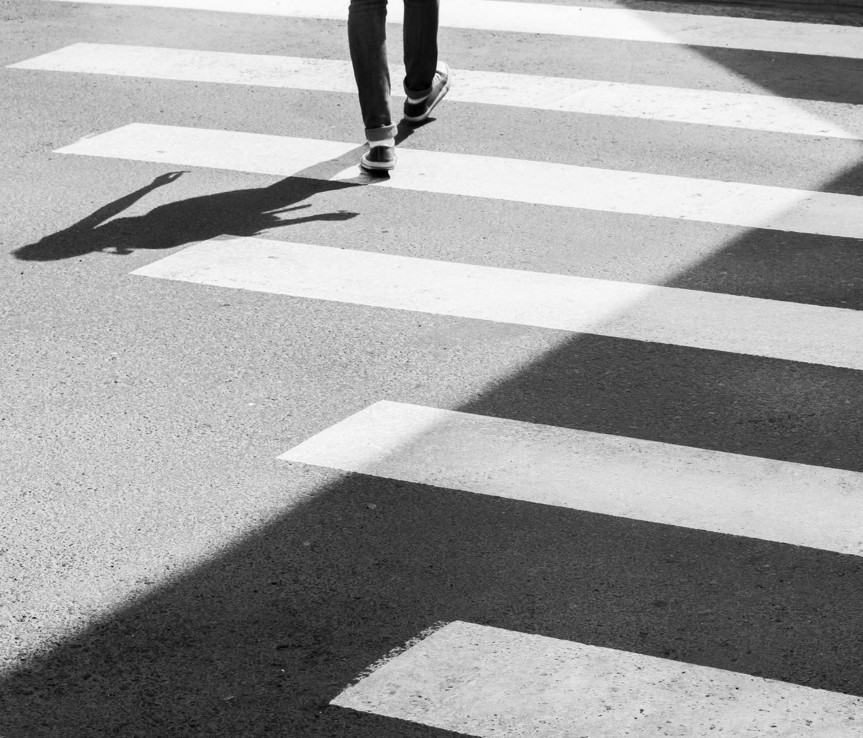
Lisa Torry Smith Act
Signed into law by Governor Greg Abbott in 2021.
The new law makes killing or injuring a pedestrian or other vulnerable road user in a crosswalk a crime in Texas.
Drivers who injure or kill a pedestrian in a crosswalk can now be charged with a misdemeanor or felony in Texas.
The law requires drivers to: Stop & Yield
It does not require proving intent
Implementation of the new law will require a statewide effort by state and local government as well as civil society

Slide 15
Background on the Term
A person from the country - an empty-headed chatterbox, like a bluejay
Dazzled by the lights of the big city they keep stopping and getting in the way of other pedestrians
Popularizing of the word
"We got trouble right here in river city"
History leading to issues today
Building roads for cars
Equity Issues

Slide 16
Topic of Conversation
why the term “jaywalking” is problematic
historical context / etymology
lack of understanding of traffic laws
minimizes the role of systemic factors for discussion
how can we talk about this topic in a more productive way?
ask ourselves what role systemic factors, particularly system design, have in influencing human behavior
to better serve our profession?
to better serve our communities?

Slide 17
How do we do better?
Better education
traffic laws for all road users and training for transportation professionals, law enforcement and the media.
Use alternative terms to describe mid-block crossings
“risky mid-block crossings”? other ideas?
More equitable approaches and design
This Photo by Unknown author is licensed under CC BY-NC.

Slide 18
Stakeholder Updates

